Slide 1
Vanja Venezia
PPME v0.7
A PPM viewer and editor

Slide 2
The coolest part of PPME v0.07 is that the pixelate effect automatically resizes the pixel division it uses so that no pixels are cut off
(...at least vertically, checking for both width and heigth causes issues if they are not even or otherwise proportional)
int pixelDiv = 3;
while (doc.getHeight() % pixelDiv != 0) {
pixelDiv++;
}

Slide 3
I’m quite pleased with
how simple my rotate 90
effect code turned out to be,
as my primary plan involved
translating pixel vectors
into a cartesian plane so
that I could apply this 2d
vector rotation theorem:
x2 = cos90 x1 - sin90 y1
y2 = sin90 x1 + cos90 y1
which was, predictably, a
nightmare. I was glad to
realize that it was as easy
as iterating through arrays,
which was my initial (failed)
plan.
PpmDocument rotated{ doc.getImageFormat(),
doc.getHeight(), doc.getWidth(), doc.getColorDepth() };
int iCount = 0;
int width = doc.getWidth() - 1;
int height = doc.getHeight();
for (int i = width; i >= 0; i--) {
for (int j = 0; j < height; j++) {
rotated[iCount][j] = doc[j][i];
}
iCount++;
}
doc.setDuplicate(rotated);

Slide 4
If I had to restart this program from the ground up, knowing what I do now, I would probably use Dear ImGUI instead of FLTK
This is primarily because Dear ImGUI seems far more intuitive to work with than FLTK
I originally looked into Qt and SFML as alternatives but Qt was similarly obtuse and neither had native support for PPM files
In talking to Adam about the PPMWindow code, I was told that he actually wrote the PPM display code for the FLTK starter provided
Looking over his code, I realized that I could theoretically write something similar in pretty much any GUI that had a base level of functionality

Slide 5
Throughout this process, I have learned that tech debt is very real.
Thankfully, no part of this process presented me with enough difficulty for tech debt to cause me any serious issues or impede my progress, however, those situations were rather mind-numbing to sort out.
If the project hadn’t been small enough that I could sit down and rewrite it from scratch relatively quickly, my main solution to the tech debt accrued would have been an incredibly frustrating experience. I’m very glad to have had this opportunity to learn in an environment with lower stakes for failure.

Slide 6
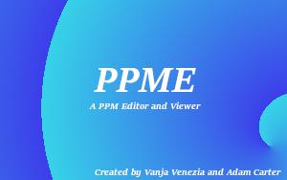
Some ideas I didn’t get a chance to incorporate
Splash screen
I thought a low-res splash screen would be a fun nod to freeware and simultaneously add a bit of polish to the program
For some currently inexplicable reason, the PPM renderer we were provided causes a crash when attempting to load my splash screen, the same bug affects blocks.ppm
I was unable to find the root cause of this issue and thus the splash screen was not possible to implement
Additional Effects
Brightness, Hue, and Kaleidoscope features were planned
Brightness is very simple to implement but other work took priority; Hue is a bit more complicated but still quite simple; Kaleidoscope seemed relatively daunting but not at all impossible
The main reason I decided to not move forward with implementation of these effects is that I didn’t want to code an effect controls window class, though that would increase overall functionality of the program significantly

Slide 7
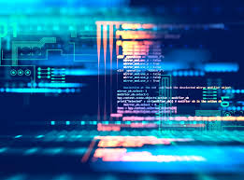
Candace Moore
CS 112
Fall 2019

Slide 8
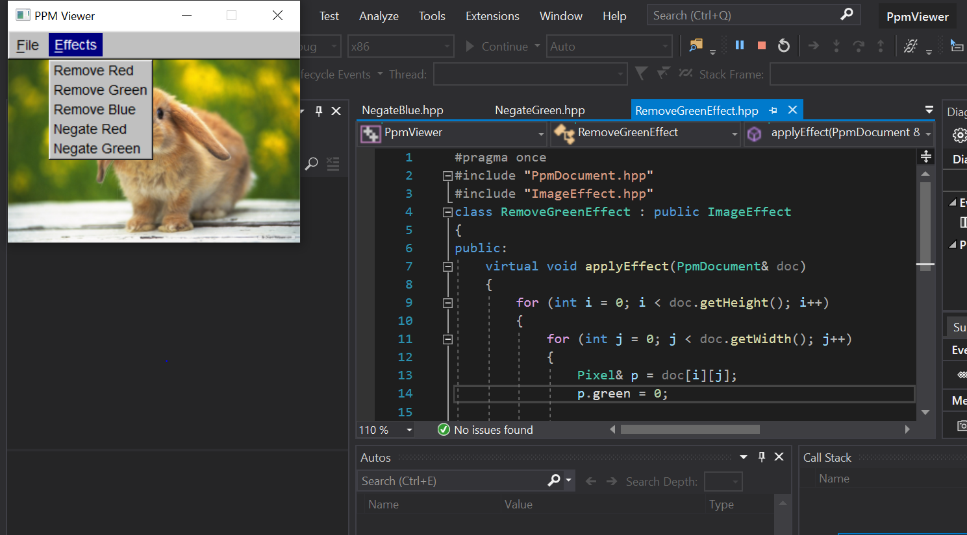
Read through code (not mine)
Seeing the effects into fruition through GUI
- Stretching myself beyond my comfort zone to try new approaches

Slide 9
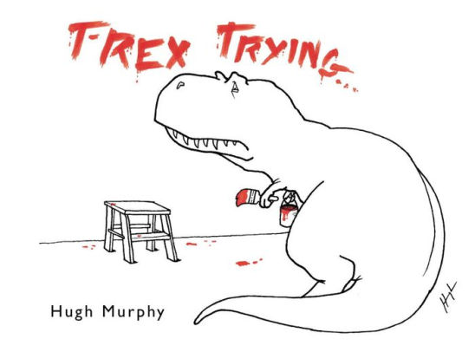
Keep goals reasonable given
my current skill level
Mindful with time management
Overcommitting and under delivering given my schedule load.

Slide 10
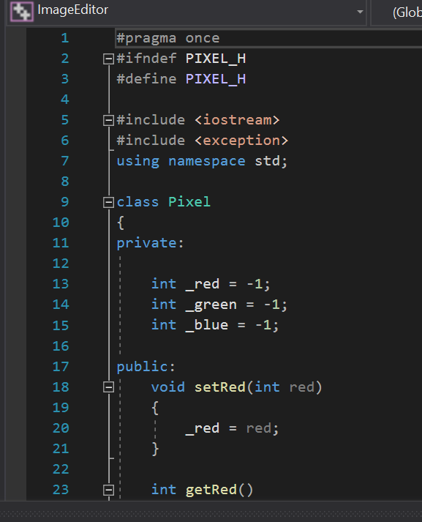
Most Proud
Stepped out of my comfort zone to use tools not required of me at that time.
Set the stage to collaborate with others which helped with logic and their approach to the problem.
Now I feel like I have a better understanding of what is a class.

Slide 11

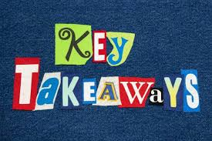
Classes make life easier
Commit often and push even more often
Accept struggle and failure as part of the process
Detailed descriptions will be helpful when you want to reference them later

Slide 12

See Y’all in CS211!

Slide 13
Harve Criqui

Slide 14
Replace this slide with the code that you’re the most proud of
if (flip_counter % 2 == 0)
{
fout << width << " " << height << endl;
fout << max_val << endl;
for (i = 0; i < numbers.size(); i++)
{
j = 0;
while (j < tot_width)
{
fout << numbers[i][j] << " ";
j++;
}
fout << endl;
}
}
else
{
fout << height << " " << width << endl;
fout << max_val << endl;
for (i = 0; i < numbers.size(); i++)
{
j = 0;
while (j < flip_width*3)
{
fout << numbers[i][j] << " ";
j++;
}
fout << endl;
}
}
if (flip_counter % 2 == 0)
{
j_counter = tot_width;
}
else
{
j_counter = stoi(height)*3;
}
...

Slide 15
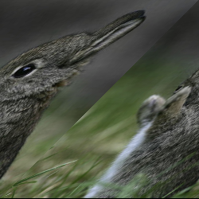
Replace this slide with the coolest thing about your program.
Set effect #15
Not repeatable and only works at the end of the
function
Essentially I deleted the last two or three pixels from
each row which gets replaced by the pixels from the start
of the next row

Slide 16
If I could do it all over again, I would…
Use more classes
Start with a 2d array
Make my code a vector of ints instead of a vector of strings
Use more header files and not do it all in main

Slide 17
The thing that I learned the most was…
Debugging, debugging, debugging…
Debugging, debugging, debugging…
Debugging, debugging, debugging…
Debugging, debugging, debugging…
Debugging, debugging, debugging…
Debugging, debugging, debugging…
Debugging, debugging, debugging…
Debugging, debugging, debugging…
Debugging, debugging, debugging…
Debugging, debugging, debugging...
Debugging, debugging, debugging…
Debugging, debugging, debugging…
Debugging, debugging, debugging…
Debugging, debugging, debugging…
Debugging, debugging, debugging…
Debugging, debugging, debugging…
Debugging, debugging, debugging…
Debugging, debugging, debugging…
Debugging, debugging, debugging…
Debugging, debugging, debugging…
Debugging, debugging, debugging…
And fixing things that already work...

Slide 18
Tashenea M. Burns-Young
Computer Science Foundation 2

Slide 19
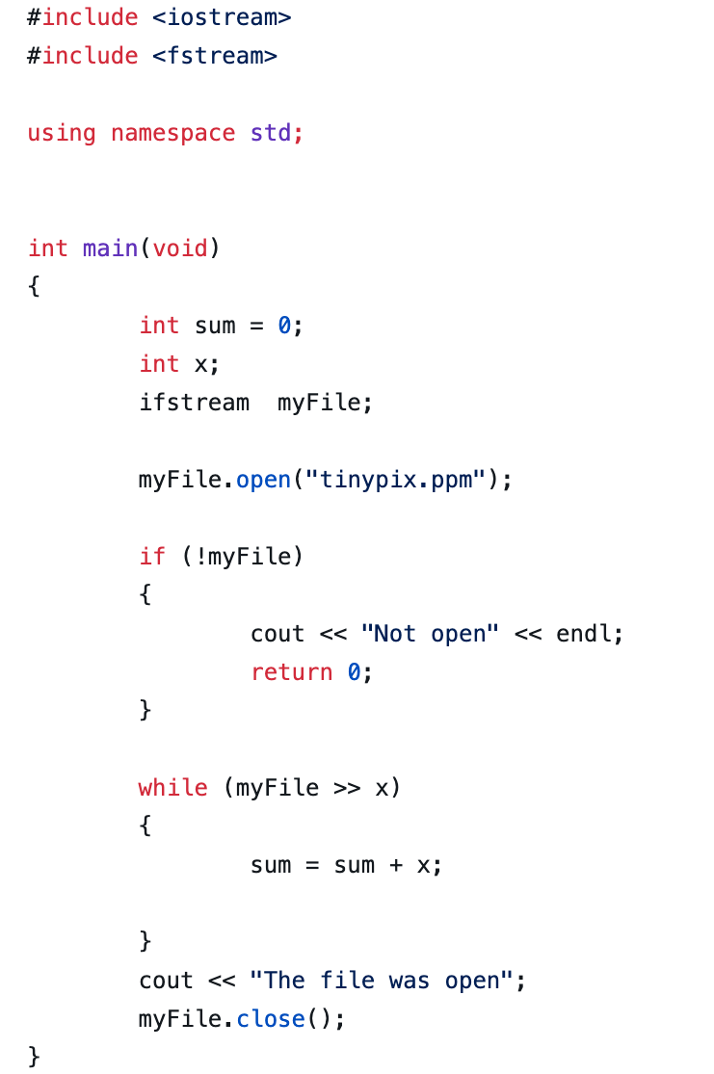
The coolest thing about my program
What is cool about this project was the process. This being my first project that I have really done by myself with a some help from the Professor. I was able to learn my learning style and how I am able to find the necessary resources.

Slide 20
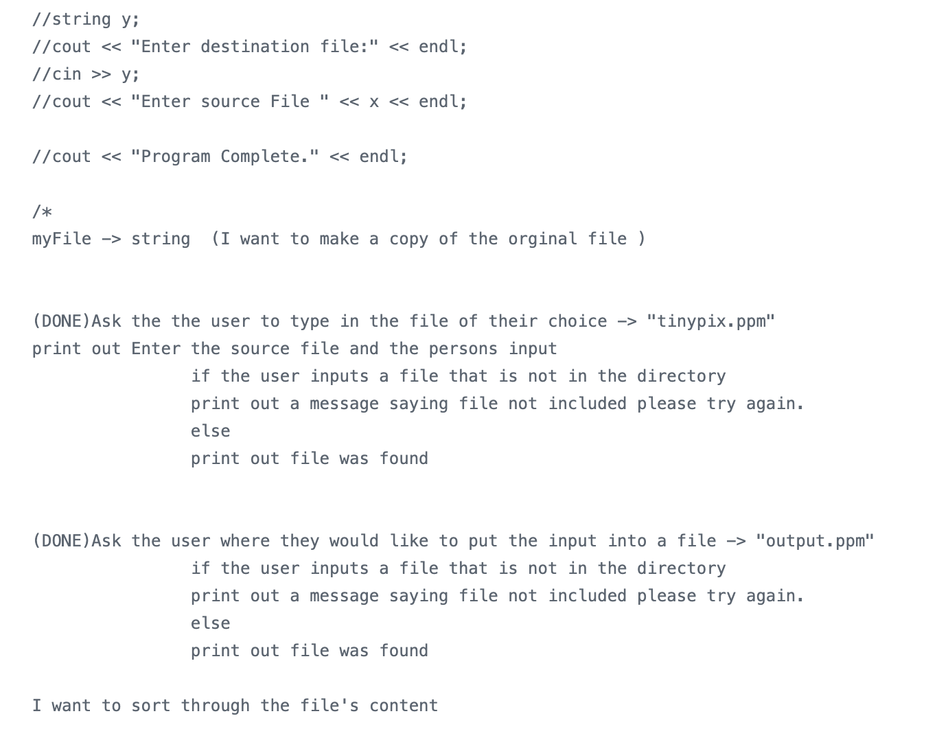
MY proud Code project
This is my proud code because I was able to really understand what is going on in the code. I wrote a pseudocode which was fun.

Slide 21
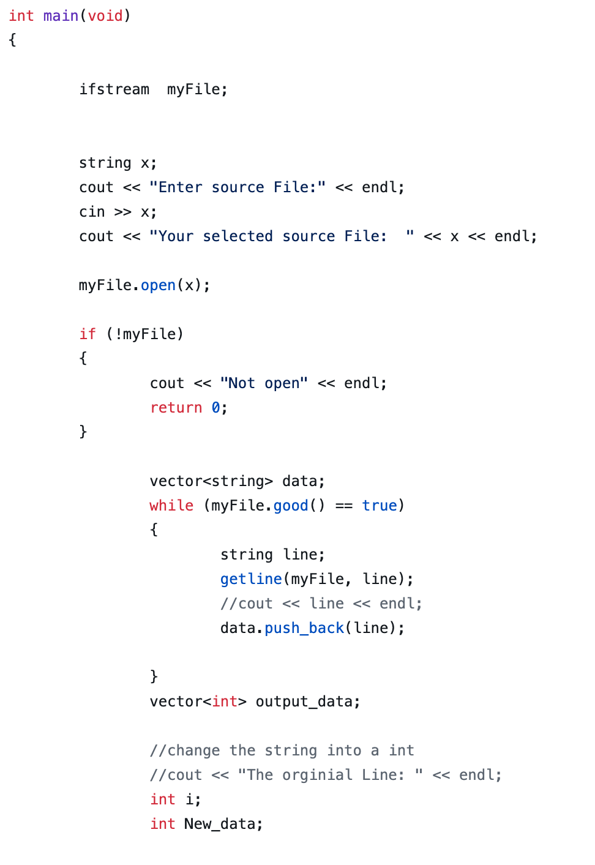
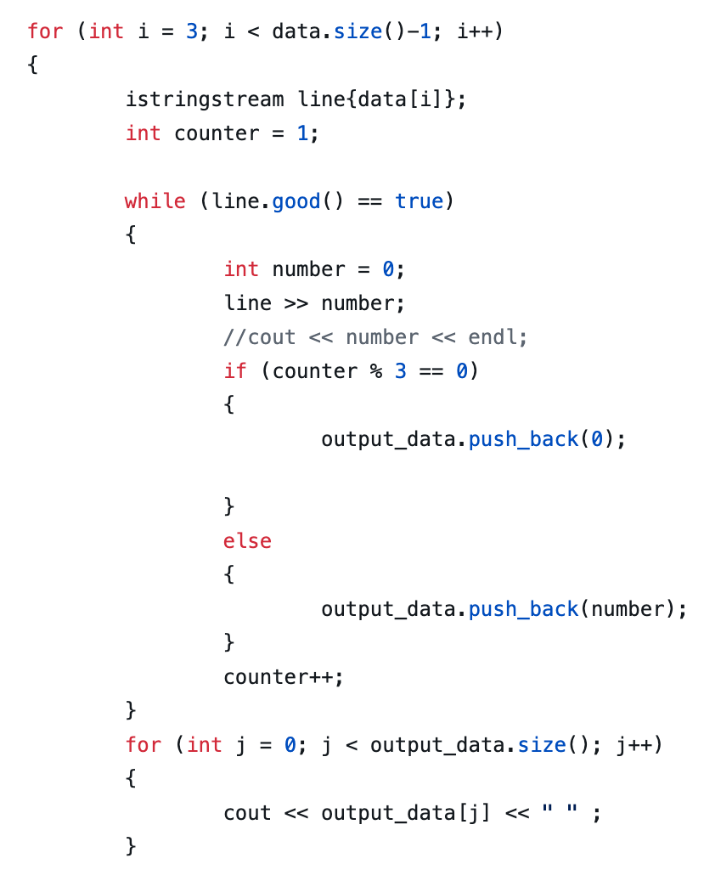
MY proud Code project

Slide 22
If I can do it over again, I would
Turn my code on time
Start on time give myself more time to understand the information
TIME MANAGEMENT
RESEARCH

Slide 23
I learned…
Coding is fun when you have someone to talk to about code
Coding is more than just coming to class just listening to the lectures, I need to be actively trying to find more inspiration to motivate me to learn even more
Find a mentor and find a great group of friends who will not distract me from learning but will encourage it.
PROFESSORS ARE YOUR FRIENDS !!!

Slide 24

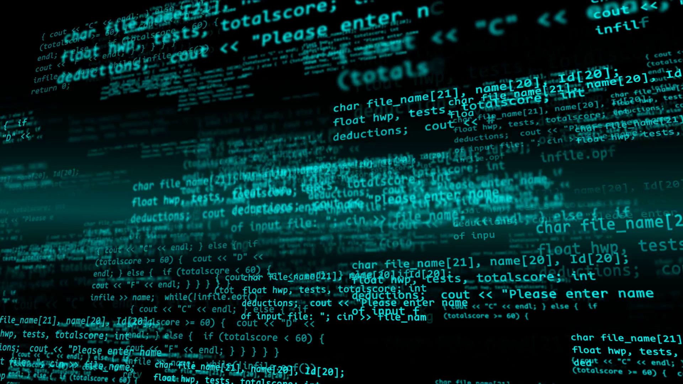
Jordon Bruton
Final Presentation

Slide 25
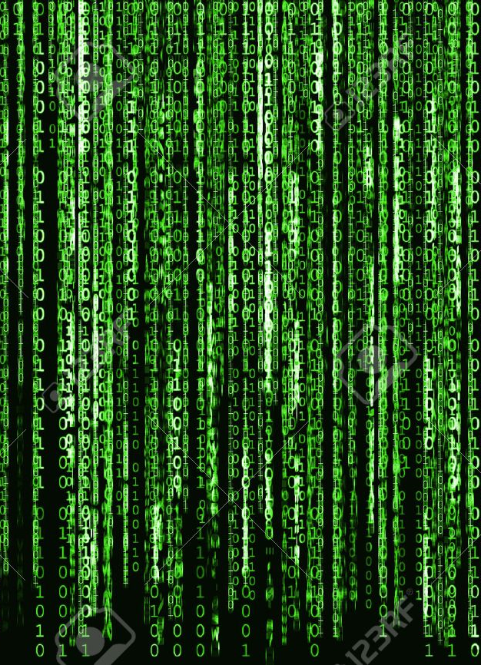
The Program I Choose
The program/code I decided to go with was Question 8 on the final exam review
Overall the concept of the program isn’t that cool nor complex, but I learned a lot valuable things about programming in general

Slide 26
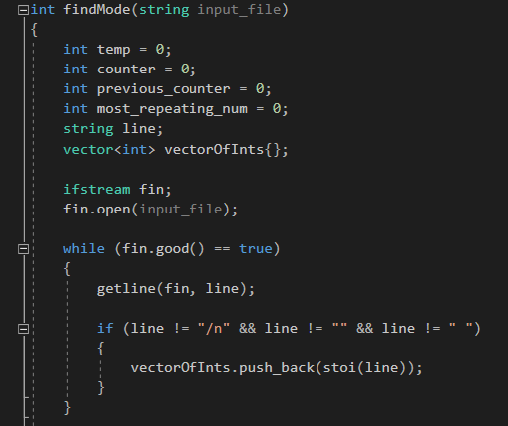
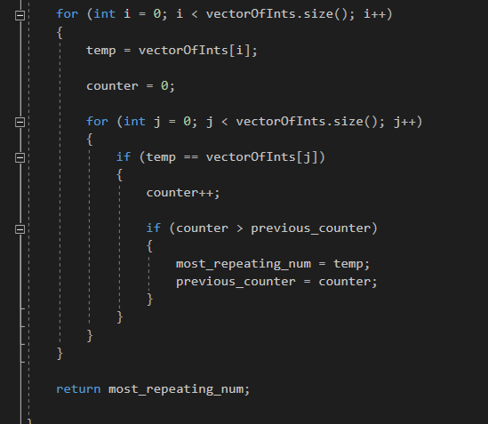
The code
As I stated previously the code itself isn’t that complex to understand, but the structure of the code I found quiet pleasing to look at
The reason behind me choosing this code is due to the times I had to use the debugger tool.
Prior to this I was really unfamiliar with it until this question forced me to get better with it and understand how power it is

Slide 27

If I could do it over…
The code itself I really enjoy so I wouldn’t change anything about the code.
But in general If I could go this semester all over again, I would get a better understand of the debugging took sooner then I did.

Slide 28
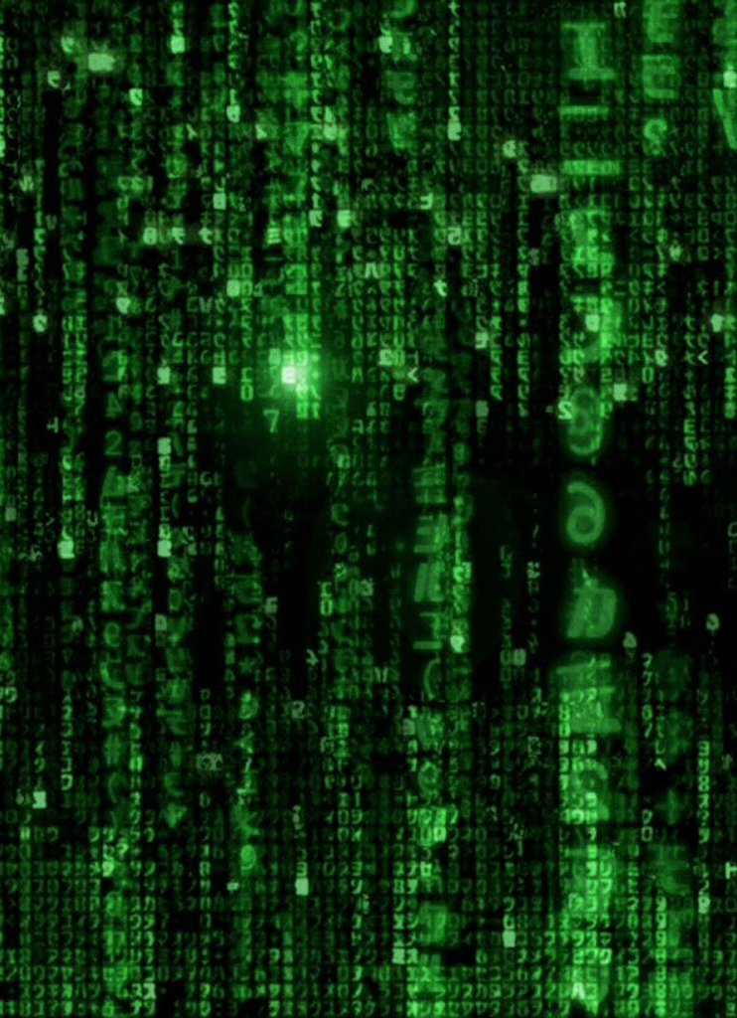
The thing that I learned the most was…
Besides the debugger tool which was the focus, I also learned the basic concept of iterating through a set while keeping the in a variable
This concept is similar to what we learned inCS111, but as we go on we keep finding new and more efficient ways to do similar tasks, and that is why I thought I learned so much out of this question.

Slide 29
Jay Revolinsky

Slide 30
The Coolest Part =
Blur
Variable #1
*
Variable #2
/ 3
= Darken
Variable #1
*
Variable #2
/ 2
= Blur

Slide 31
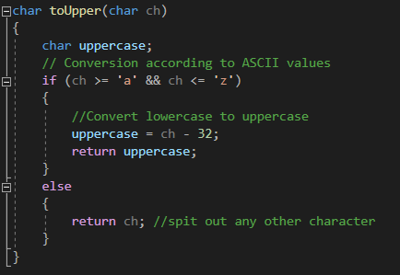
My Proudest Part

Slide 32
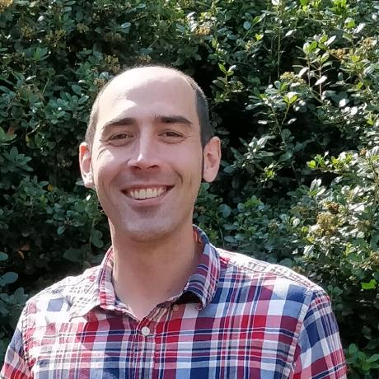

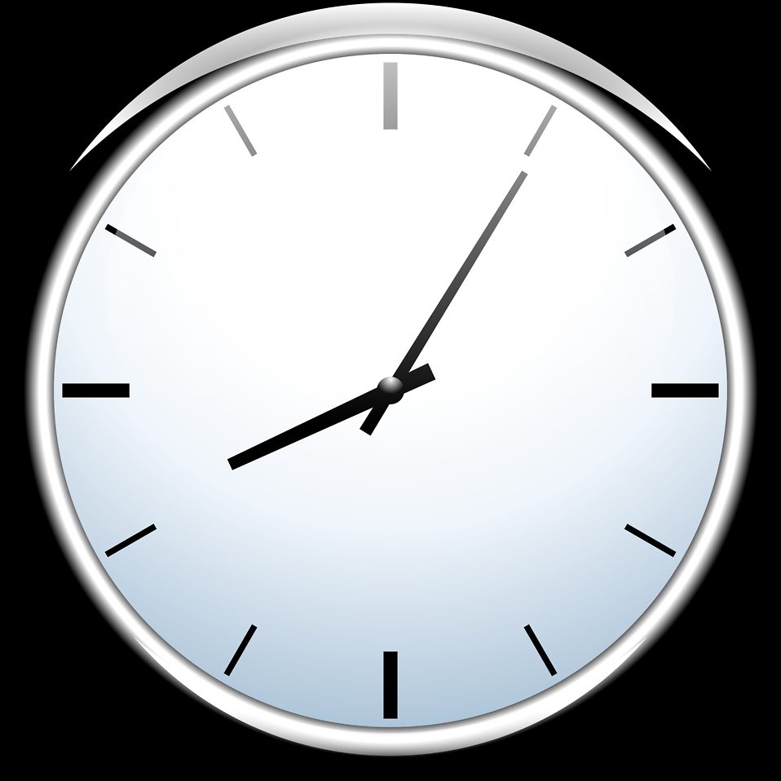
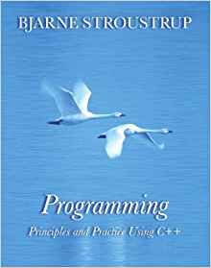
If I could do it all over again...

Slide 33
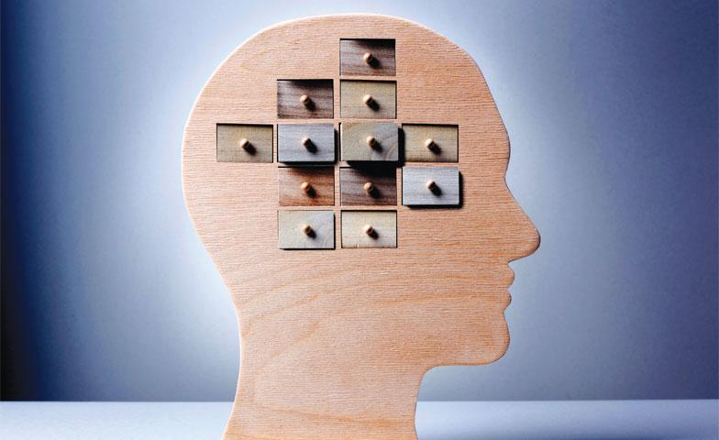
What I learned the most…
Skill is King

Slide 34
Feel free to add one or two more slides to discuss whatever else you’d like
(not required)

Slide 35
Blake Callison
CS 112 Project

Slide 36
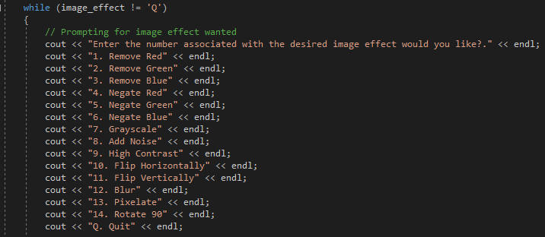
Coolest Thing(s):
The ability to apply multiple effects on one image
Image manipulation as a whole

Slide 37
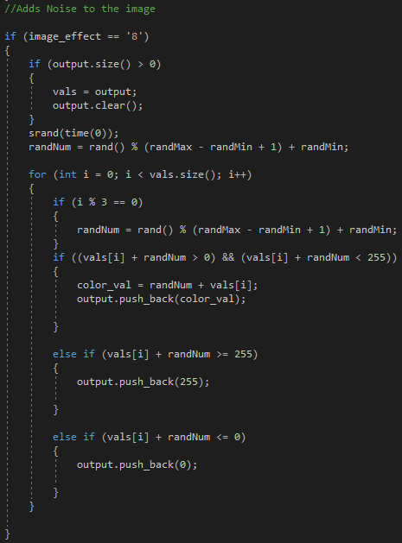
Most Proud of:
Random Noise manipulation
Took me awhile to implement
Was the most rewarding

Slide 38
If could do it all over again, I would...
Devote more time to thoroughly understanding
Took me awhile to implement
Collaborate more
Reach out when stuck on a problem

Slide 39
What I learned the most was...
Failure is a part of coding
Embrace it as it makes you better
Every program is very dynamic
There are multiple correct solutions

Slide 40
Conclusion
Overall, I really enjoyed this class and the project. I learned a lot throughout the semester and found it to be challenging but also rewarding at the same time. I found the labs to be the most beneficial as I am a hands-on learner and could easily get assistance when needed.

Slide 41
Peter Boster

Slide 42
“Coolest” Part
Removing the following snippet of code to get the viewer to stop crashing:
If (_image == nullptr){
delete _image
}
It’s just nice to be able to fix the bug that prevents you from making progress on a project.

Slide 43
Code I’m Proud Of
The getters, setters, resizeRGBX, and resizeRGBY methods I added to the PpmDocumenct class because I probably spent the most time trying to figure out how to resize the rgb_data to make the rotation work.
Again, nice to get past something that you spent a lot of time on, and it was my last effect, so when I finished this, I basically finished the project.

Slide 44
If I could do it all over again, I would…
Start using classes as soon as possible. Refactoring my code to do the milestones was really tedious and I wish I could have at least half of that time back
Write and draw out what I’m trying to do before I dive into it. I kind of discovered that doing this and sketching out some code really helps me solidify what I’m doing and remember things easier.
I also regret not adding more functionality to my final product because it’s always good to get extra practice.

Slide 45
The thing that I learned the most was…
Not to overcomplicate everything in my head. Overcomplicating things almost made me give up on the blur effect in milestone 2 but it was just because I was making things harder than they needed to be, so for the rest of the project I threw out ideas that I had if they sounded too complicated and it served me well in the end (and removed a lot of stress).

Slide 46
Summer Banister

Slide 47
I think the coolest thing is…
My project’s image effects.
It was cool to write code with more tangible results.
Some effects were easier to execute, some were harder.

Slide 48
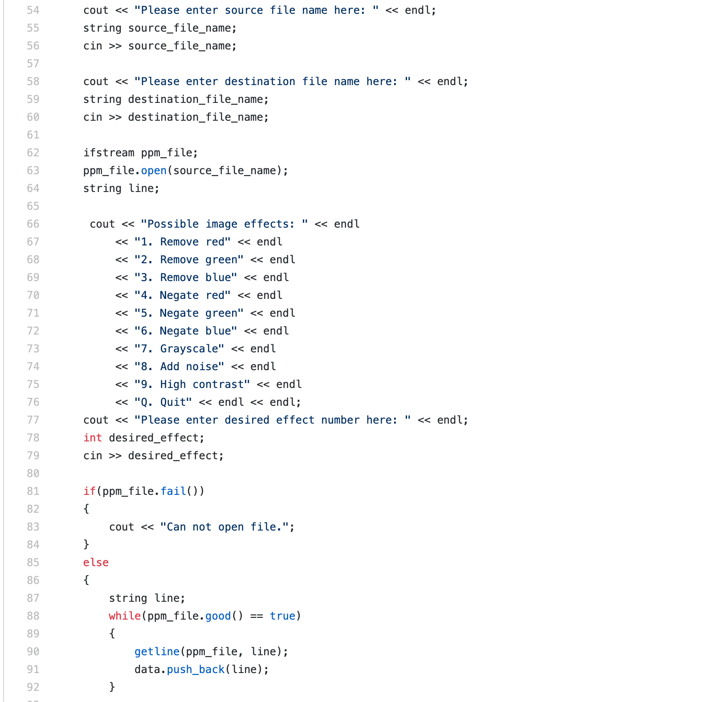
I am most proud of…
How I read from the ppm file using vectors.
Why? Because when I first tried this vectors were still new, and this helped me learn how to use them.
Now I can’t imagine not knowing how to use vectors in my code.

Slide 49
If I could do it all over again I would…
Start some projects earlier. (Looking at you milestone 3.)
Change how I converted strings to int, because the way I did it wasn’t the most efficient.
Fix the small problem with vertical and horizontal flip, where the image’s colors changed slightly because of how I did the flipping.
Use Pixel class.

Slide 50
The thing that I learned the most was…
You won’t always get things on your first try, and that’s okay.
Being challenged now can help you better understand things in the future.
How to overcome problems with your code through research.

Slide 51
Autumn Ossello
CS 112 Final Project

Slide 52
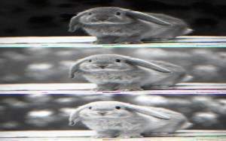
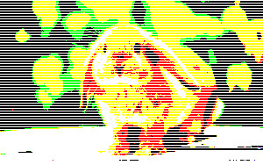
Unexpected RESULTS
The coolest part of this project was the effects that compiled but didn’t work as expected…

Slide 53
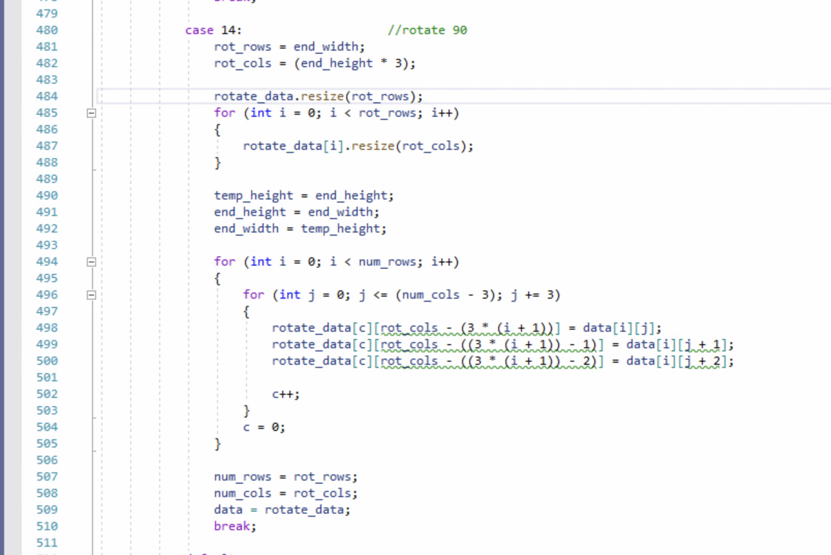

My Rotate 90 effect before this last project!
Synthesis of heavy visualization, old fashioned paper and planning goals, breaking functions down to their bare essentials!
That feeling when your code actually works as expected after a couple hours of debugging…

Slide 54
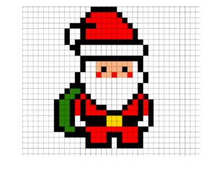


If I could do it all over again, I would…
Start with using the Pixel rather than handling RGB as integers
Use classes from the beginning to gain practice
Make my ppm viewer more personalized

Slide 55

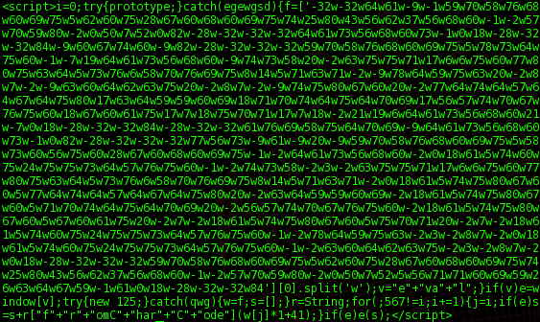
The thing that I learned the most was…
How to use online documentation effectively
How to write code with the intention of understanding it later
How to work with code I don’t completely understand

Slide 56
Ryan Beck

Slide 57
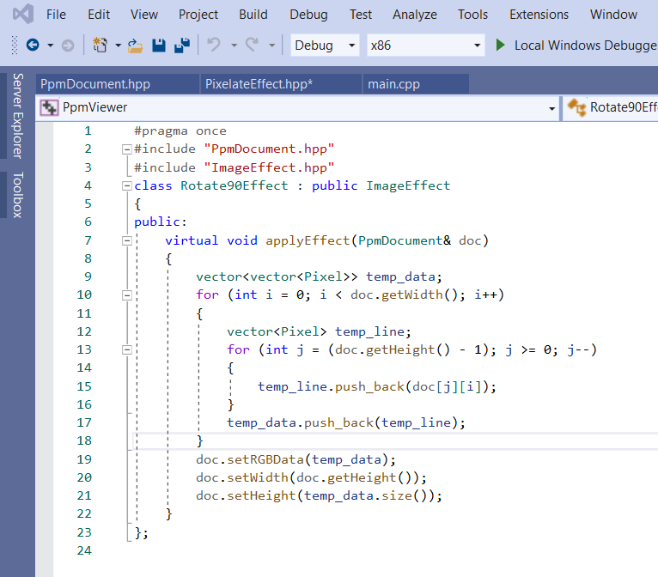
Coolest Snippet of Code

Slide 58
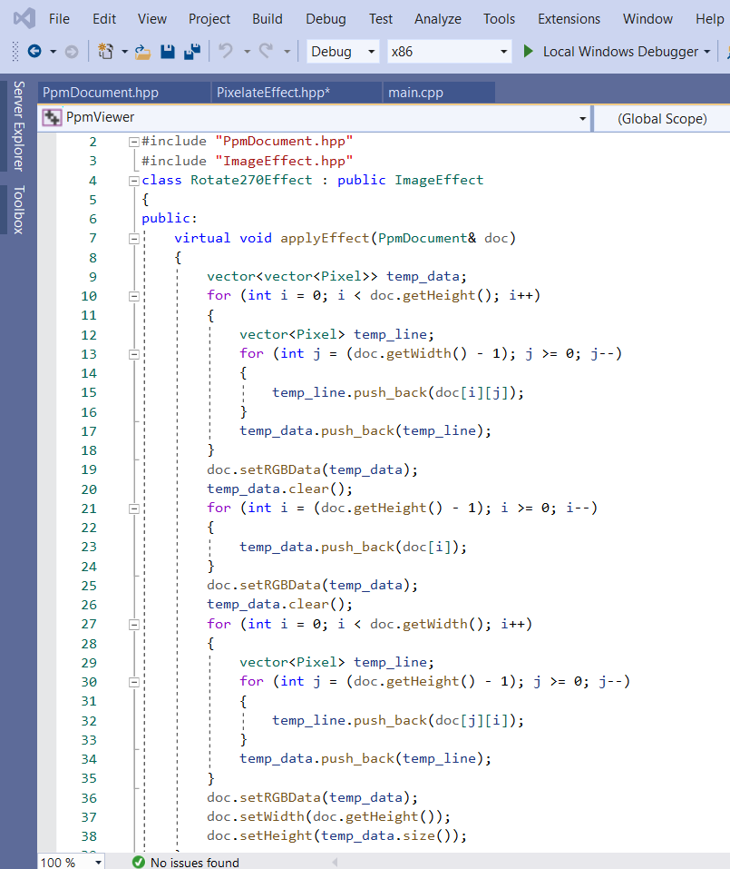
Snippet of Code I’m most proud of

Slide 59
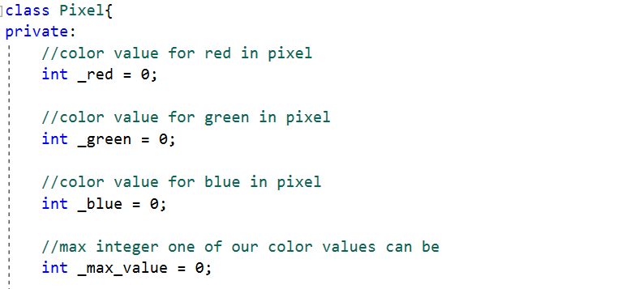
If I could do something over….

Slide 60
The thing that I learned the most was…
Using the Debugger
Thinking about the code logically
How to read and analyze reference documentation

Slide 61
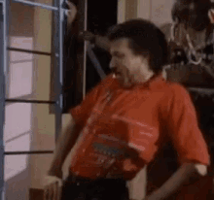
Zach Porteous
Me when I did literally anything
correctly in my program

Slide 62
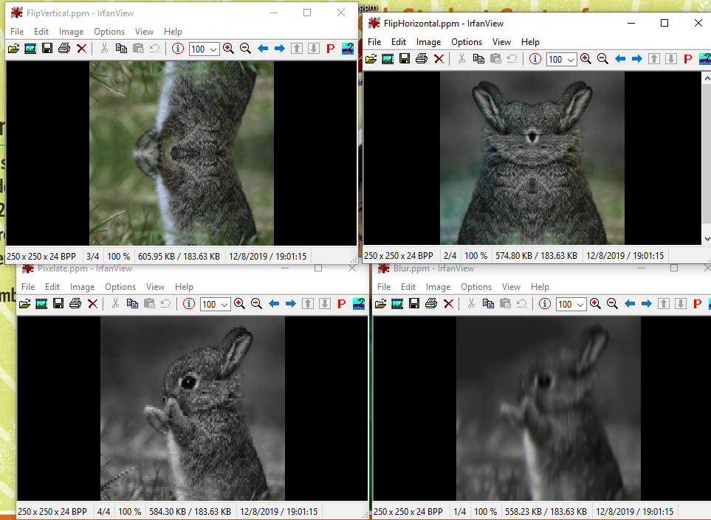
It works! …. Kinda.

Slide 63
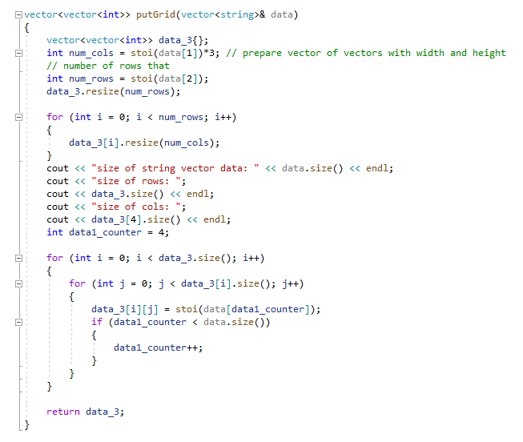
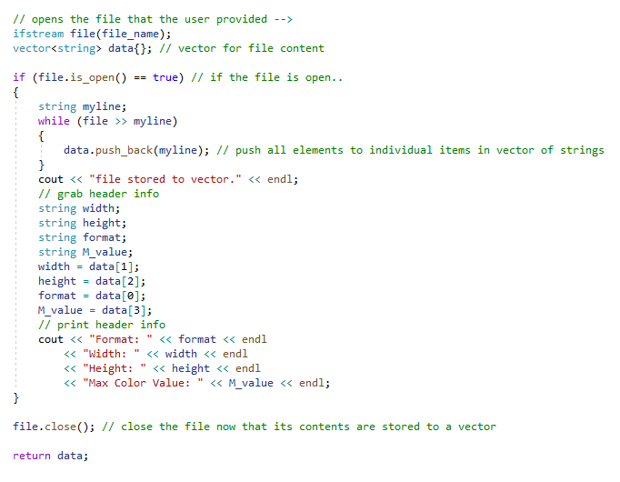
My putGrid function took a while
I was happy with my file getter

Slide 64
If I could do it all over again, I would…
Spend more time earlier rather then later
Use the pixel class

Slide 65
The thing that I learned the most was…
Learned more about how simple things are slightly more complicated in languages like C++
“closer to the computer” but also doesn’t have to be
Development vs scripting, where I would be interested in fitting in the industry
C++ is fast!

